Slide 1



Spanning Tree Algorithms in Network and Infrastructure Planning
A comprehensive survey of classical and advanced spanning tree algorithms for modern infrastructure optimization.
Jatin Kumar-24BDA70126
Harsh Vardhan verma-24BDa70147
Manjot Singh-24DA70084 ,Nischal Sharma-24BDA7105

Slide 2



Why Spanning Trees Matter
The Challenge
Real-World Impact
Modern infrastructure—power grids, telecommunications, transportation networks—demands efficient connectivity. Spanning tree algorithms solve a fundamental problem: connecting all nodes at minimum cost while ensuring reliability and sustainability.
Google's global fiber network uses optimized routing to reduce latency. India's power grid employs tree-based topologies to balance load and minimize energy loss. European transportation systems use graph algorithms for cost-effective logistics routes.

Slide 3

Historical Evolution of MST Research
1
1926: Borůvka's Discovery
Czech mathematician Otakar Borůvka introduces the first MST algorithm to minimize electrical wiring costs for power stations, marking the birth of combinatorial optimization.
2
1956: Kruskal's Algorithm
Joseph Kruskal proposes a greedy edge-based approach, reducing computational complexity and improving practical applicability.
3
1957: Prim's Algorithm
Robert Prim independently develops a vertex-based greedy method, optimizing performance for dense graphs.
4
1983: GHS Algorithm
Gallager, Humblet, and Spira introduce distributed MST computation for asynchronous networks, enabling real-time infrastructure systems.

Slide 4




Three Classical Centralized Algorithms
Borůvka's Algorithm
Kruskal's Algorithm
Component-based approach where each component selects its minimum outgoing edge. Components merge iteratively until one remains. Time complexity: O(E log V). Ideal for parallel systems.
Global greedy strategy: sort all edges by weight, then add edges without creating cycles using Union-Find. Time complexity: O(E log E). Performs exceptionally well on sparse graphs like road networks.
Prim's Algorithm
Vertex-based approach starting from an arbitrary node, repeatedly adding the smallest-weight edge connecting the tree to outside vertices. With Fibonacci heap: O(E + V log V). Optimal for dense graphs.

Slide 5

Distributed and Protocol-Level Implementations
As networks scaled to continental proportions, distributed algorithms became essential. The Gallager–Humblet–Spira (GHS) algorithm operates without global knowledge, using asynchronous message-passing where each node acts independently. Message complexity is O(E + V log V), making it suitable for real distributed systems like sensor networks and peer-to-peer systems.
At the data link layer, the Spanning Tree Protocol (STP) prevents loops in Ethernet networks. Modern variants include Rapid STP (RSTP) for faster convergence and Multiple STP (MSTP) for load balancing across multiple VLANs. These protocol-level implementations demonstrate spanning tree concepts' lasting relevance in networking infrastructure.

Slide 6




Real-World Infrastructure Applications
Power Distribution Networks
Transportation & Logistics
MSTs minimize total electrical cabling costs while providing a base topology. Additional links ensure redundancy and fault tolerance in case of overloads or failures.
MSTs form cost-efficient backbone routes for pipelines, fiber networks, and road systems. Geographic Information Systems integrate MST algorithms to generate preliminary layouts refined with environmental constraints.
Telecommunications
Smart Cities & IoT
MSTs underpin backbone network design, minimizing link costs while maintaining full connectivity. Used in cellular tower placement, fiber routing, and satellite communication design.
Networks of IoT sensors use MST-based clustering and routing for energy-efficient data aggregation. Dynamic or energy-aware MST algorithms are especially valuable for battery-powered devices.

Slide 7

Limitations of Traditional MST Approaches
Single-Objective Focus
Traditional algorithms minimize only total cost, neglecting latency, energy efficiency, and fault tolerance—all critical in real infrastructure.
Static Network Assumption
Modern networks change topology as nodes move or fail. Traditional MSTs assume static graphs and require full recomputation when topologies change.
Energy Constraints Ignored
In wireless sensor networks, traditional MSTs can rapidly deplete certain nodes' energy reserves, causing network partitioning and premature failure.
Lack of Redundancy
MSTs inherently avoid cycles, providing no redundancy. Real infrastructure demands multiple paths for fault recovery and resilience.

Slide 8
Energy-Aware MST: A Modern Solution
The Energy-Aware Minimum Spanning Tree (EA-MST) model addresses modern infrastructure challenges by integrating node energy levels directly into topology construction. Instead of minimizing cost alone, EA-MST balances cost and energy distribution.
Modified Edge-Weight Formula: w'(u,v) = α × w(u,v) + (1-α) × |E_u - E_v|
Where α weights the trade-off between original cost and energy imbalance penalty. This ensures nodes with low remaining energy are less likely to become communication hubs, distributing load evenly and extending network lifetime.
O(E log V)
25-40%
42%
Computational Complexity
Energy Variance Reduction
Network Lifetime Improvement
Minimal overhead—weight modification adds only O(E) preprocessing time.
Simulation shows significant decrease in energy imbalance across nodes.
Average node lifetime increases from 100 to 142 cycles in test scenarios.

Slide 9
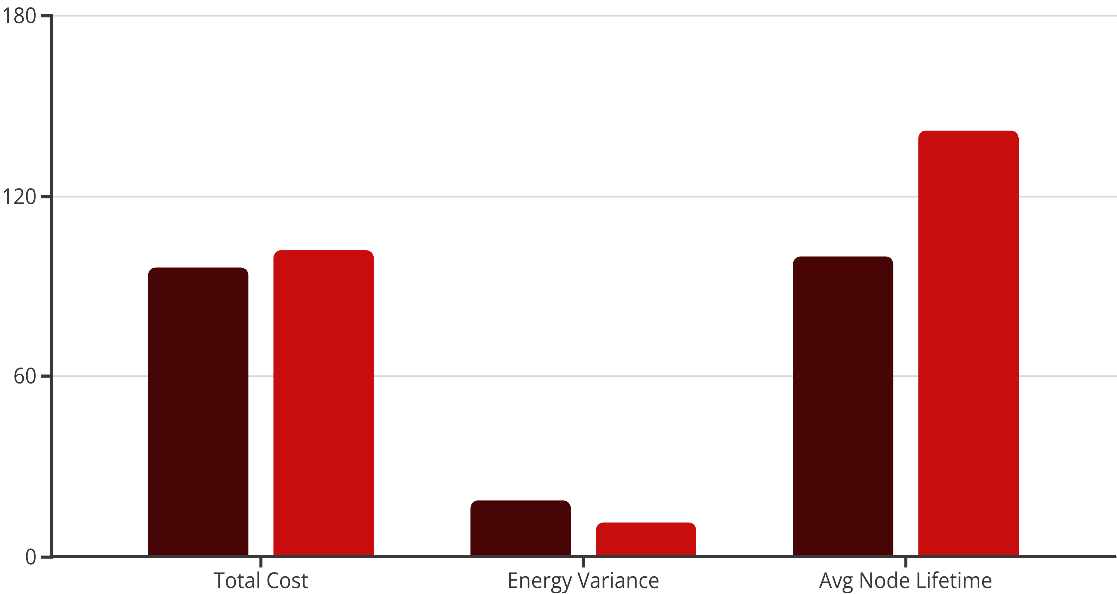
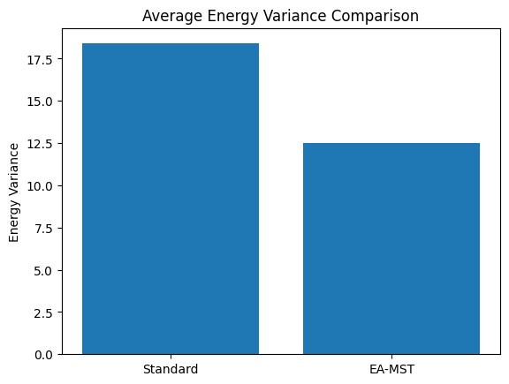
Implementation Results and Performance Metrics
Python simulations using NetworkX compared standard MST against Energy-Aware MST on randomly generated networks with 10-50 nodes, using α=0.7 (70% priority to cost, 30% to energy balance).
Standard MST
Energy-Aware MST
Results confirm EA-MST's trade-off: modest cost overhead (~6%) yields significant improvements in energy balance (39% variance reduction) and network longevity (42% lifetime extension). The algorithm preserves classical MST simplicity while extending applicability to energy-sensitive systems like wireless sensor networks and IoT infrastructures.

Slide 10

Conclusion and Future Directions
Spanning tree algorithms remain foundational tools in network optimization, evolving from Borůvka's 1926 electrical grid problem to modern distributed and energy-aware variants. This survey examined classical centralized approaches (Borůvka, Kruskal, Prim), distributed algorithms (GHS), and protocol implementations (STP, RSTP, MSTP).
The proposed Energy-Aware MST model successfully addresses limitations of static, cost-only approaches by incorporating energy constraints into topology construction. Simulation results demonstrate improved energy balance and extended network lifetime with minimal computational overhead.
Multi-Objective Optimization
Machine Learning Integration
Combining cost, latency, and reliability constraints for comprehensive infrastructure planning.
Adaptive tuning of the α-parameter using ML algorithms for dynamic optimization.
Probabilistic Networks
Real Hardware Implementation
Extending the model to temporal and probabilistic networks for improved fault tolerance.
Deploying EA-MST in actual sensor networks and SDN controllers for dynamic adaptation.

